Slide 1

A Business Analysis Presentation Presented By: Arpit Rimza
CRISTALLO MOTORBIKES
CASE STUDY
Analysing the Impact of Quality Scores, Complaints, and Absenteeism of Employees on
Quality of Electric Motorcycle Production

Slide 2

Table of Content
Introduction
Methodology
Business Understanding
Data Analysis
Conclusion & Recommendations

Slide 3

Introduction
Cristallo Motorcycles, an electric motorbike manufacturing firm, has been witnessing an increase in demand for its four bike models. The company has well-planned processes and resources in practice.
However, customer complaints pertaining to quality issues, not being able to achieve the expected production capacity, and absenteeism of employees on key processes are adding to the stress of the respective management teams. Sources of these problems need to be identified and addressed to achieve sustainable growth.
The purpose of this Data Analysis presentation is to provide data-driven recommendations and insights to address the management of Cristallo Motorcycles, and it covers an appraisal of the analysis conducted in accordance with the data provided on Production Quality and HR Absent.

Slide 4
Introduction
The provided dataset included information on Production Quality and Customer Complaints and Absenteeism of Employees.
Relationships and patterns have been established between variables like Quality Score, Production Time, Type of Complaint for different Bike Models and Employee Absent Rates for different Job Titles and Shifts to understand how these affect the overall Production Quality.
The methodology includes the use of Descriptive Statistical methods in a Data Analysis framework to look for trends and patterns in data for different variables before coming to logical conclusions and providing recommendations to improve the company’s existing processes and increase its capacity to meet future demands in a sustainable manner.

Slide 5
Methodology
Business Understanding/ Objectives of the Analysis
What the business wants to accomplish and identify the criteria to gauge success
Data Collection and Preparation
Checking the data for errors and completeness and Creating new Metrics to use for Analysis
Data Analysis using Descriptive Statistics and Pivot Tables
Production Quality Analysis (Bike Models and Power System)
HR Absent Analysis (Job Titles, Shifts and Gender)
Sharing the Results/ Evidence-based Solutions using Data Visualisation and Pivot Charts
Effectively communicating the findings through data-driven storytelling
Providing Recommendations
Providing recommendations that are supported by evidence in order to improve decision-making based on data insights

Slide 6
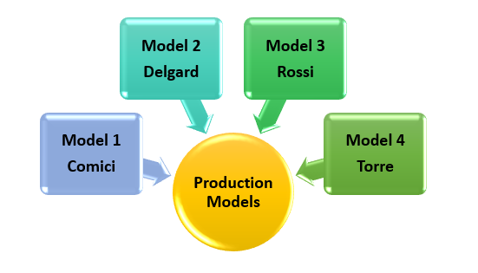
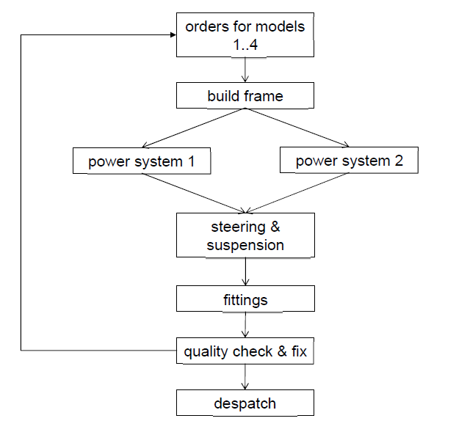
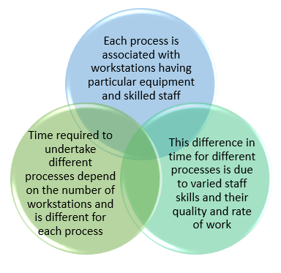
Business Understanding
Cristallo Motorcycles is a manufacturer of specialist motorcycles with four production models which share the same basic frame.
The production process involves the following steps:

Slide 7

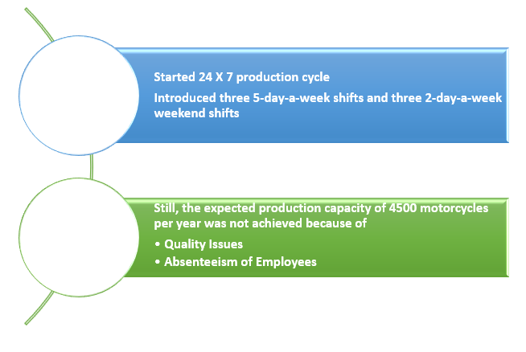
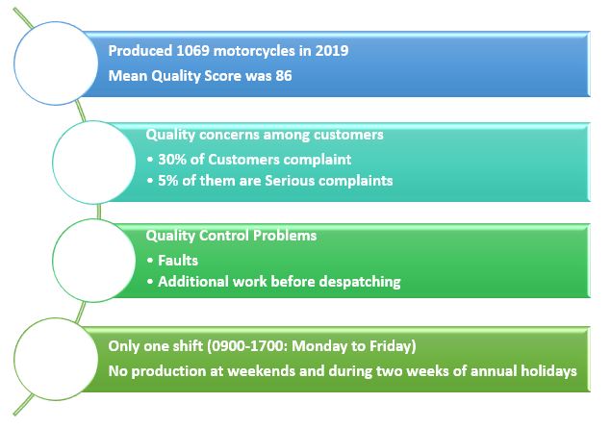
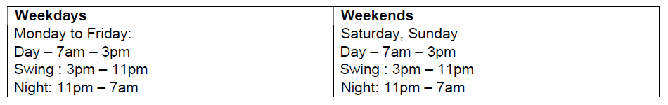
Business Understanding
According to the 2020 data, the following is summarised:
As per the 2019 data, the following is summarised:

Slide 8
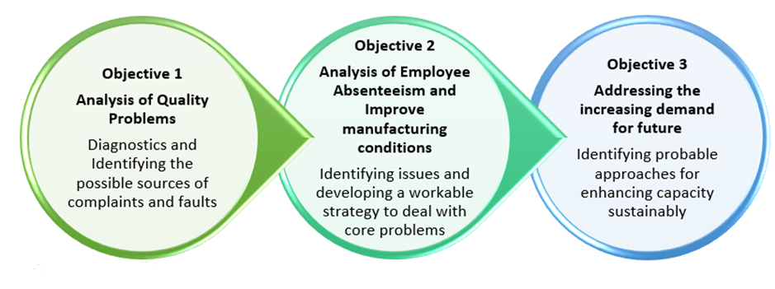
Objectives of the Analysis

Slide 9
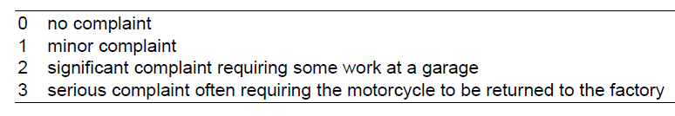
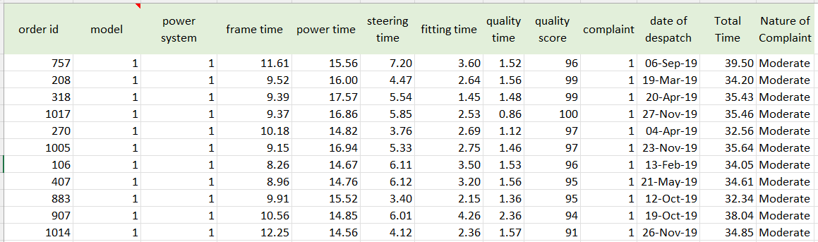
Description of Dataset
The Quality Score is given after a thorough inspection of the entire motorcycle but before any defects are rectified (on a scale of 0-100).
Another new column “Nature of Complaint” was created by assigning the following:
For complaints analysis, 0 (no complaints) observations have been removed
1 (Minor) and 2 (Significant) Complaints have been aggregated into “Moderate” Complaints
3 (Serious) Complaints have been coded as “Serious” Complaints
Initially, the Complaints were coded as:

Slide 10
Description of Dataset
The Quality Score is given after a thorough inspection of the entire motorcycle but before any defects are rectified (on a scale of 0-100).
Another new column “Nature of Complaint” was created by assigning the following:
For complaints analysis, 0 (no complaints) observations have been removed
1 (Minor) and 2 (Significant) Complaints have been aggregated into “Moderate” Complaints
3 (Serious) Complaints have been coded as “Serious” Complaints
Initially, the Complaints were coded as:

Slide 11
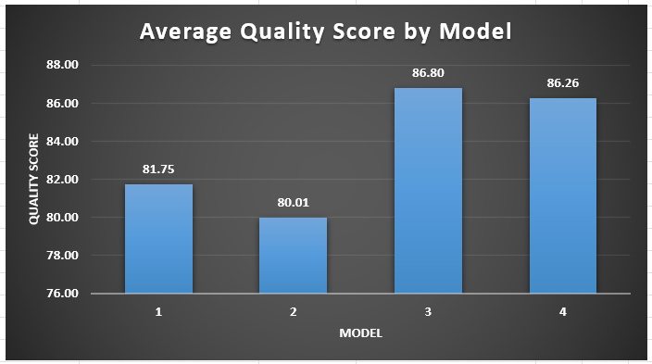
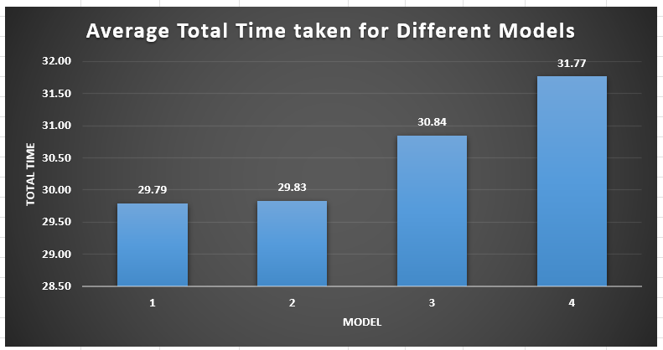
Production Quality Analysis
Analysis of different Bike Models
Average Quality Score for different Models
Average Total Production Time taken for Different Models
Model 4 takes the maximum production time and has a high Average Quality Score
Model 3 has moderate production time but has the maximum Average Quality Score
Model 1 and Model 2 take the minimum production time and have less Average Quality Score
Model 3 and Model 4 have the highest Average Quality Scores (marginal difference)
Model 2 has the worst Average Quality Score

Slide 12
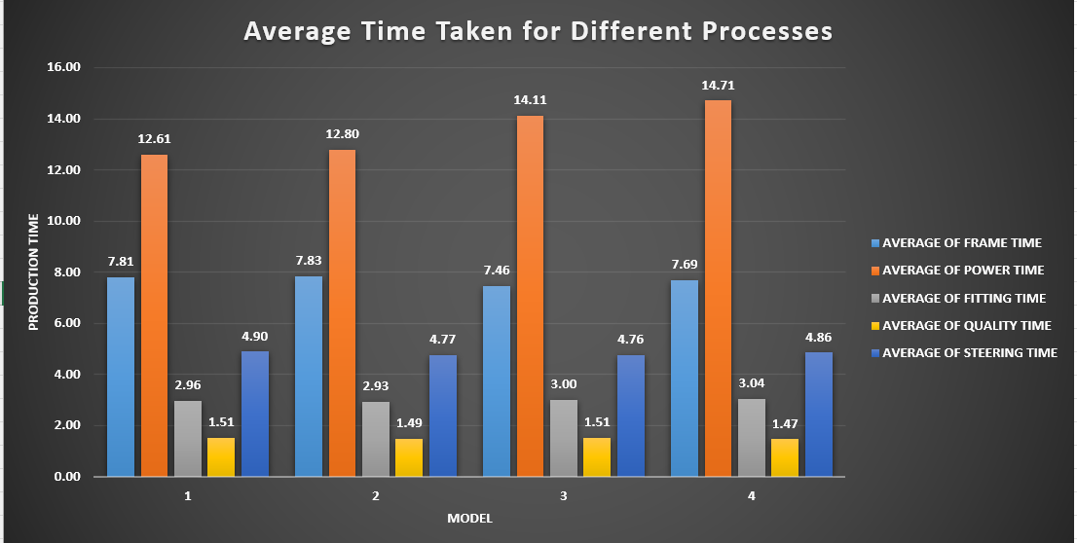
Production Quality Analysis
Analysis of different Bike Models
Average Time Taken for Individual Processes
Installing Power Systems is the most time-consuming stage in the production process
Quality Checks process takes the least time in the production process
Models 3 and 4 take more Average Power Time than Models 1 and 2

Slide 13
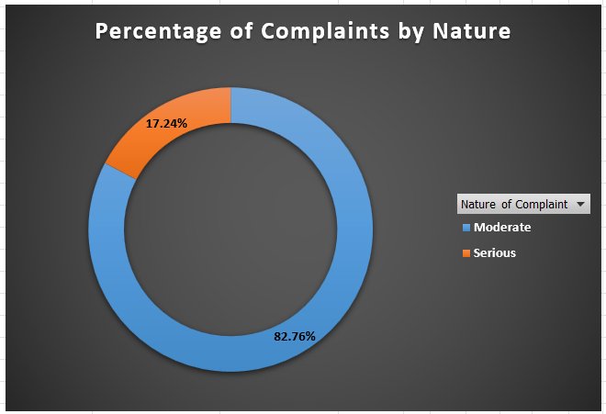
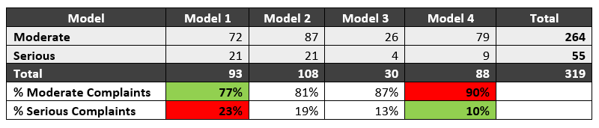
Production Quality Analysis
Analysis of different Bike Models
Nature of Complaints for different Models
Model 4 has the highest % and Model 1 has the lowest % of Moderate Complaints
Model 1 has the highest % and Model 4 has the lowest % of Serious Complaints
Models 3 and 4 have low % of Serious Complaints but high % of Moderate Complaints
Models 1 and 2 are poor in terms of Quality Score and also have a high % of Serious Complaints
Maximum Complaints are for Model 2 and minimum complaints are for Model 3 (Model 3 has the best Quality Score)
Moderate Complaints occupy a significant portion of the total complaints (82.76%) which do not need bikes to be sent to the factory for rework

Slide 14
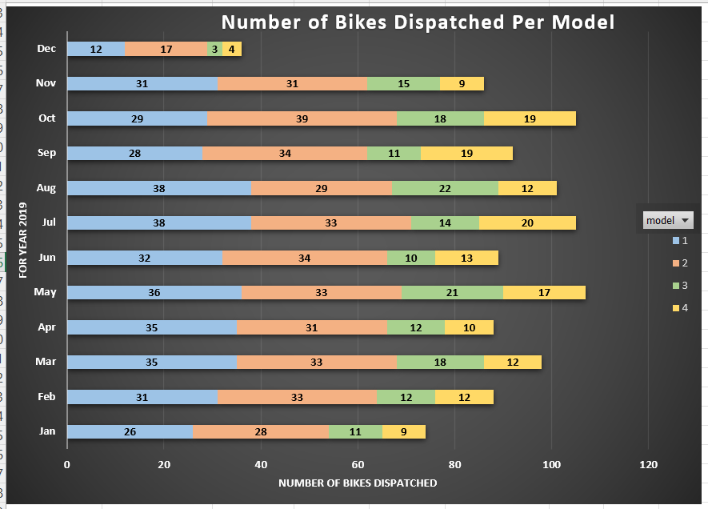
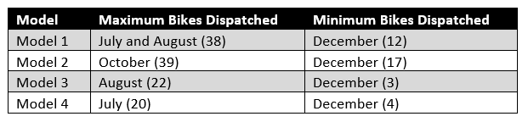
Production Quality Analysis
Analysis of different Bike Models
Number of Bikes Dispatched per Model in different Months of 2019
Model 1 and 2 bikes were the most dispatched despite having less Quality Scores and Model 3 and 4 bikes had low dispatch quantities despite having high Quality Scores
Overall, the maximum number of bikes was dispatched in May
Overall, the minimum number of bikes were dispatched in December, this might be due to the two weeks of holidays during Christmas/New Year when the production stopped

Slide 15
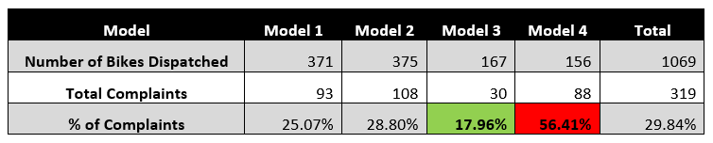
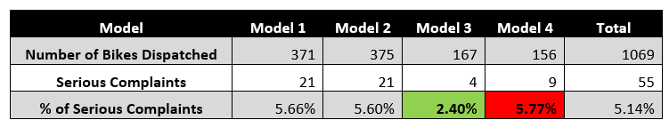
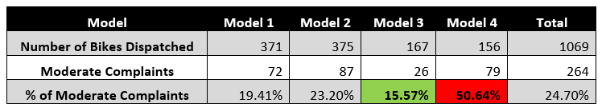
Production Quality Analysis
Analysis of different Bike Models
Percentage of Complaints to Bikes dispatched for different models
Model 4 has the highest % and Model 3 has the lowest % of Complaints out of the Total Bikes dispatched
Model 4 has the highest % and Model 3 has the lowest % of Serious Complaints out of the Total Bikes dispatched
Model 4 has the highest % and Model 3 has the lowest % of Moderate Complaints out of the Total Bikes dispatched
Despite having High Quality Score Model 4 has the highest % of Moderate and Serious Complaints

Slide 16
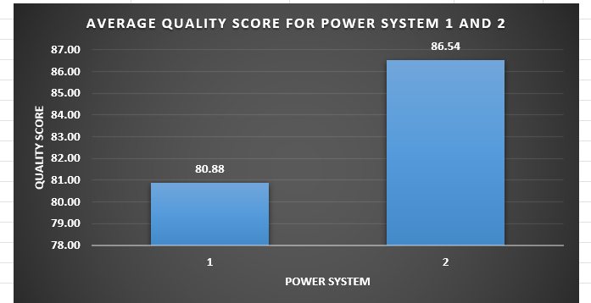
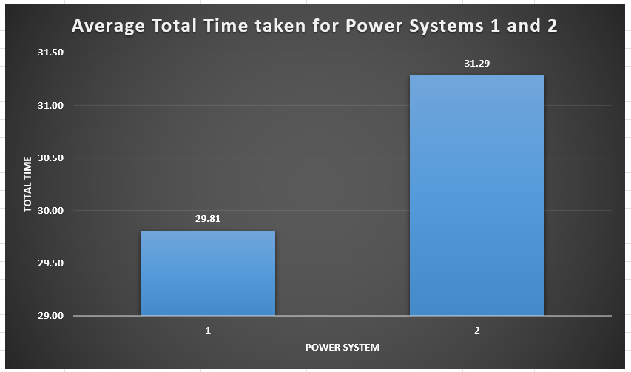
Production Quality Analysis
Analysis of Power Systems
Average Quality Score for Power Systems 1 and 2
Average Total Time for Power Systems 1 and 2
Average Quality Score for Power System 2 is higher than that of Power System 1 (Power System 1 is used for Models 1 and 2, and Power System 2 is used for Models 3 and 4)
Power System 2 takes more time for production and has a higher Quality Score

Slide 17
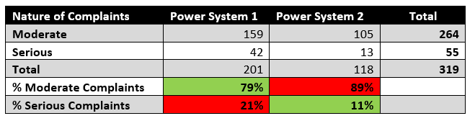
Production Quality Analysis
Analysis of Power Systems
Nature of Complaints for Power Systems 1 and 2
Power System 1 has a higher % of Serious Complaints and has low Quality Score
Power System 2 has a higher % of Moderate Complaints and has high Quality Score

Slide 18
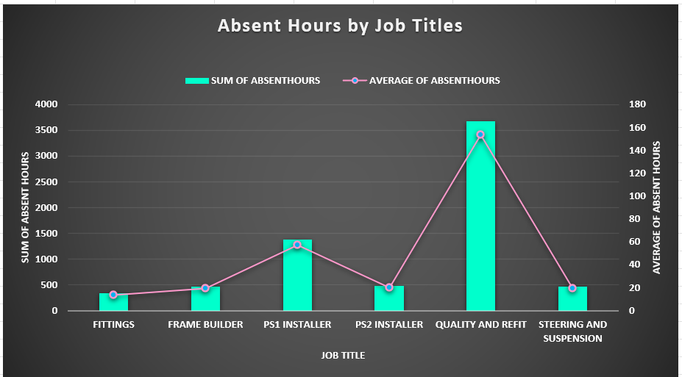
HR Absent Analysis
Analysis by Job Titles
Absent Hours for different Job Titles
Quality and Refit workers were absent the most which affected the quality of production
Power Station 1 installers were also absent for a high amount of time which might have led to a low Quality Score and a high % of Serious Complaints
Fittings, Frame Builders, and Steering and Suspension workers have very low Average Absent Hours which might not have affected the Production much

Slide 19
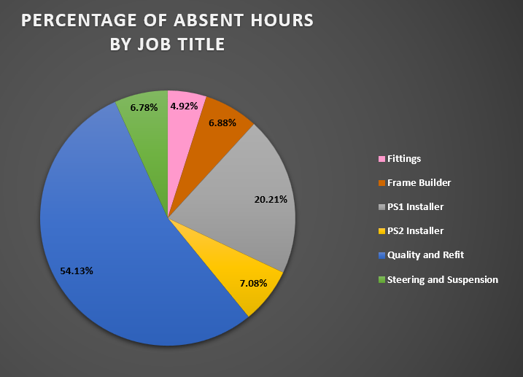
HR Absent Analysis
Analysis by Job Titles
Absent Hours for different Job Titles
Quality and Refit workers contribute towards more than half of the total Absent Hours

Slide 20
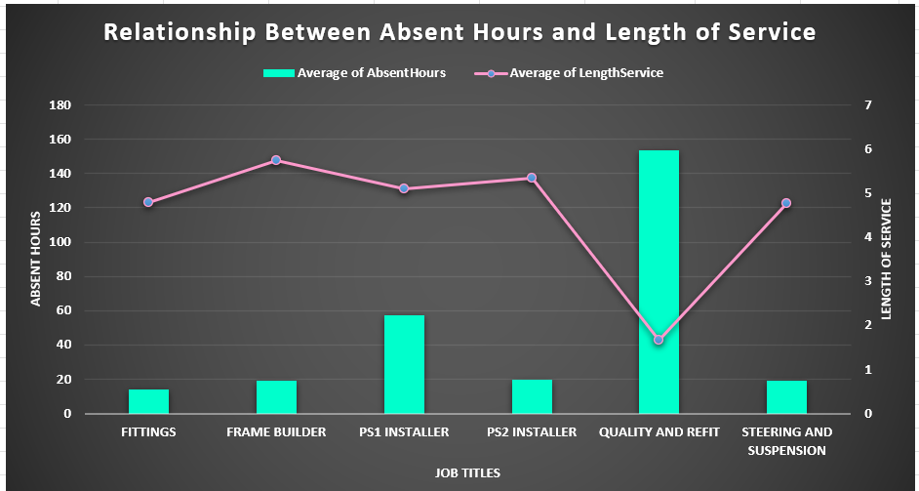
HR Absent Analysis
Analysis by Job Titles
Relationship between Absent Hours and Length of Service
The Absent Hours and Length of Service are almost negatively correlated, i.e., the workers having less Length of Service are the ones with the most Absent Hours, and less experienced employees seem to be most absent
Quality and Refit workers have the minimum Length of Service and are most Absent, which is extremely affecting the Production Quality
The other category of workers have fewer Absent Hours but a high Length of Service, meaning they take their jobs seriously
Power Station 1 Installers have a high Length of Service but also have moderate Absent Hours, meaning they affect the Production which might have led to a low Quality Score and a high % of Serious Complaints

Slide 21
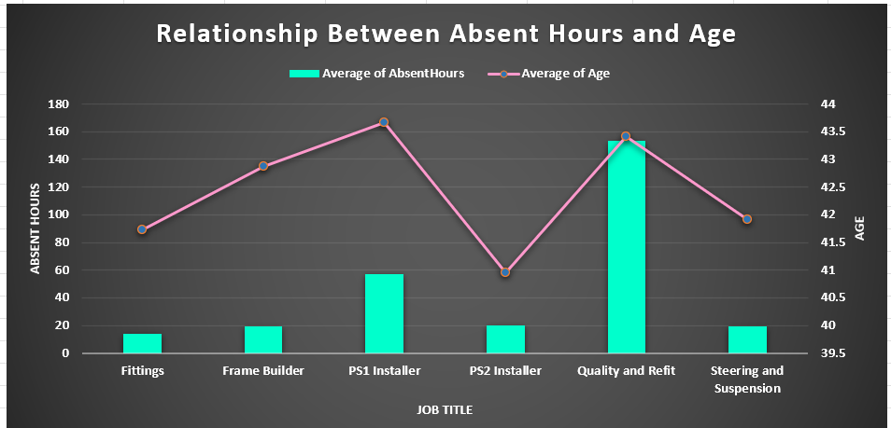
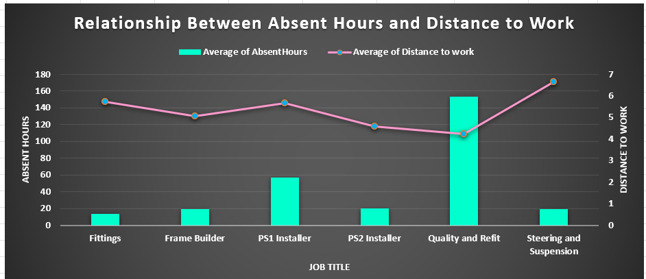
HR Absent Analysis
Analysis by Job Titles
Relationship between Absent Hours and Age
Relationship between Absent Hours and Distance to Work
Quality and Refit workers and PS1 Installers both have high Average Age and are also Absent the most, meaning for these two categories, the workers of higher age are highly absent
Quality and Refit workers have the least Average Distance to Work but still have the Highest Absent Hours, hence, there seems to be a serious problem with Quality Workers

Slide 22
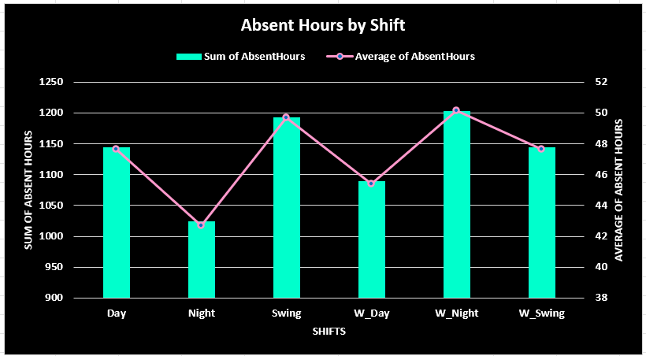
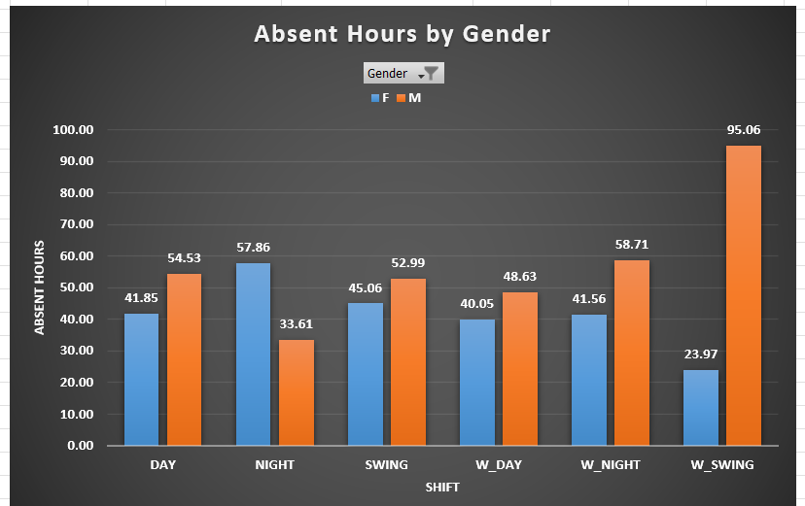
HR Absent Analysis
Analysis by Shifts
Absent Hours by Shift
Absent Hours by Gender across different Shifts
Employees have problems working on Night Shift during weekends but are comfortable working on Night Shift during weekdays
Males have problems working on weekend Swing Shifts but are comfortable working on weekday Night Shift
Females have problems working on weekday Night Shifts but are comfortable working on weekend Swing Shifts

Slide 23
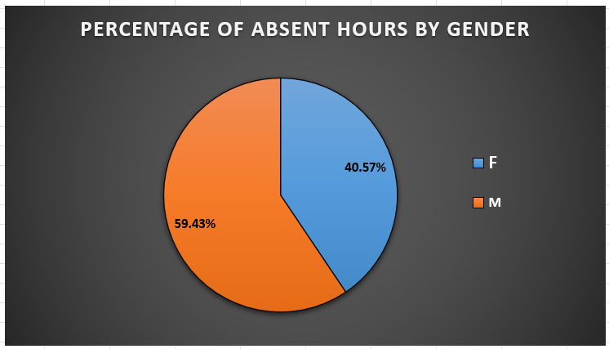
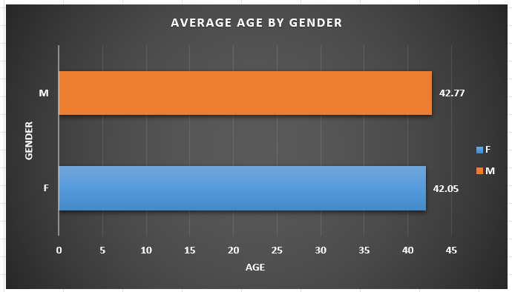
HR Absent Analysis
Analysis by Gender
Absent Hours by Gender
Average Age by Gender
Males have a higher % of Average Absent Hours as compared to Females
There is not much significant difference in Age for both the Genders

Slide 24
Conclusion/Insights
Absent Hours
Bike Model
Quality and Refit workers account for the highest % of Absent Hours
Quality and Refit workers are least experienced in terms of minimum Length of Service, have the highest Average Age, and stay most nearby to work location, still they are absent the most
Workers belonging to the Weekend Night Shift are absent the most
Male workers belonging to Weekend Swing Shift and Female workers belonging to Weekday Night Shift are Absent the most
Male workers belonging to Weekday Night Shift and Female workers belonging to Weekend Swing Shift are Absent the least
Model with the highest Average Quality Score is Model 3 (Rossi) and one with lowest is Model 2 (Delgard)
Model 4 takes the most Production Time but also has considerably high Quality Score
Out of total complaints received, Model 2 has the highest % of complaints and Model 3 has the lowest %
Out of the total bikes dispatched per model, Model 4 has the highest % of complaints (both Serious and Moderate) followed by Model 2
Power System
Power System 1 has a low Average Quality Score but also takes less production time
Power System 1 accounts for 63% of the total complaints received
Installing Power Systems takes the maximum time, whereas Quality Checks take the least time in the Production Process.

Slide 25
Recommendations
Power System
Use of Power System 1 should be paused for production since it has low Quality Score and high % of Complaints and Power System 2 should be fully released into production for a duration of 6 months, during which the feedback can be monitored to observe how well it performs alone
Objective 1 – Analysis of Quality Problems
Bike Model
Production of Model 2 (Delgard) should be stopped as it has least Quality Score and also has maximum % of Total Complaints, instead focus should be made on Model 3 that has the highest Quality Score and least % of Complaints
Since Model 4 (Torre) has high expectations from customer, it is expected to have high Complaints, and it takes highest Production Time. On the contrary, it has High Quality Score. Balancing all of these factors, its production cannot be stopped, however, steps must be taken to reduce the % of Complaints per dispatched bike

Slide 26
Recommendations
Objective 2 – Analysis of Employee Absenteeism and improve manufacturing conditions
Absent Hours of Quality and Refit workers is questionably high, despite it being the most important process. This is an area the HR department should look seriously into. Since Power System 1 has experienced workers, and Power System 1 can be paused meanwhile for production, those workers can be shifted to the Quality and Refit department to balance the workload and enhance the Quality process
Weekend Night shift has the highest Absent Hours. The HR department can check in on the productivity of these workers and have meetings with the head of departments to know how to solve such issues. A solution might be to rotate the night shift amongst all workers and provide additional incentives to those working on Weekend Night Shifts to decrease the Absent Hours
Male workers belonging to Weekend Swing Shift and Female workers belonging to Weekday Night Shift are Absent the most, and Male workers belonging to Weekday Night Shift and Female workers belonging to Weekend Swing Shift are Absent the least. These shifts can be interchanged among the two Genders and results may be observed
There is no provision at present to monitor staff performance on individual stages. Employee performance should be monitored by a Performance Management System in a predictable and quantifiable way. This will ensure that all workers accomplish the tasks at individual processes efficiently
These recommendations when implemented can help company achieve yearly expected production of 4500 motorcycles, and also reduce the costs and delivery time

Slide 27
Recommendations
Objective 3 – Addressing the increasing demand for the future
Additionally, since the Quality Process has the most Absenteeism, and gets the least process time, few new workstations can be built and staff can be recruited as a capacity investment plan. This can incorporate more Quality Checks taking few minutes at each stage, but this can reduce rework to help increase effective capacity in future
More data needs to be gathered to test how Production Time affects the Quality Score. This can create many causal relationships which can help to undertake a more detailed analysis
Probability data can be gathered to understand the risk of a Bike having Serious or Moderate Complaint
Revenue and Profit data may be provided to analyse the company’s financials on sales of motorcycles and whether the expected target is achieved

Slide 28
Thank You

